Slide 1

ADA Threshold and Basic Design
ADA 2.0
Kristie Billiar | ADA Policy Program Manager
November 8, 2017

Slide 2

Thresholds
(what to do when)

Slide 3
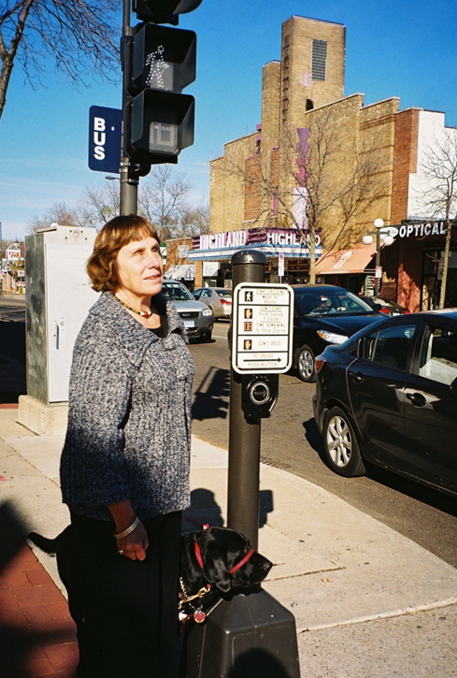
Using Your Transition Plan
Your transition plan has identified what need to be done and the law defines when it needs to be done
The transition plan serves two functions it sets the baseline to measure progress and gives a broad outline for investment and scoping
Facilities are an asset and condition is related to their accessibility

Slide 4
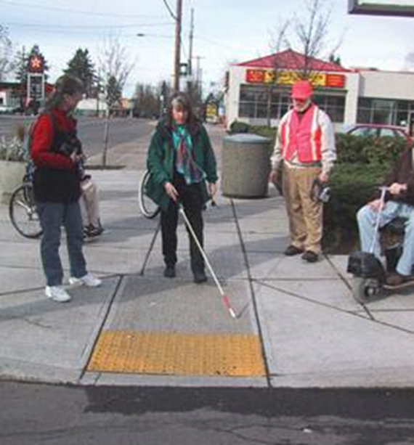
Alteration Threshold
Curb ramps must be done whenever there is alteration level work
The accessibility improvements must be done AT THE SAME TIME or PRIOR to the alterations work.
There are tradeoffs with either approach

Slide 5
Right of Way and Alterations
Public entities are required to obtain Right of Way to provide accessibility when needed.
If right of way is not obtained and the facility is non compliant the entity must be able to demonstrate that reasonable efforts were made to obtain it

Slide 6
Alteration Work Types
The DOJ has identified the following work types as an alteration:
Mill and Overlay
Mill and fill
Addition of New Layer of Asphalt,
Hot In-Place Recycling,
Open-graded Surface Course,
Thin lift overlays
Micro-surfacing,
Cape Seals,
Asphalt and Concrete Rehabilitation,
Concrete repair: Isolated, partial and/or full-depth repairs to restore functionality of the slab; e.g., edge spalls, corner breaks Bridge joint replacement
Bridge Deck Overlays

Slide 7
Maintenance Work Types
The DOJ has identified the following work types as maintenance:
Asphalt crack sealing
Bituminous pavement seal coat
Chip sealing
Isolated concrete dowel-bar retrofit
Concrete joint sealing
Concrete pavement surface planning / diamond grinding
Slurry seals
Bridge substructure preservation: concrete and steel
Bridge superstructure activities: Painting, bearing rehabilitation/replacement and barrier/guardrail/railing restoration.
Surface Sealing
Fog Seals
Scrub Sealing
Joint Crack Seals
Joint repairs
Spot High-Friction Treatments

Slide 8

Maintenance Work
Accessibility improvements are not required with maintenance activities
Doing two or more maintenance activities may trip the alterations threshold, but this is not well defined

Slide 9
Accessible Design
(what is it)

Slide 10
The Basics
ADA is an element of good pedestrian design and complete street concepts
Design that is focused only on ADA is difficult to maintain and can unintentionally refocus the context of the corridor.
Rather than focus on compliance MnDOT advises focusing on usability, maintainability, and constructability
Slopes and dimensions are absolute; ADA/PROWAG allows no tolerances

Slide 11
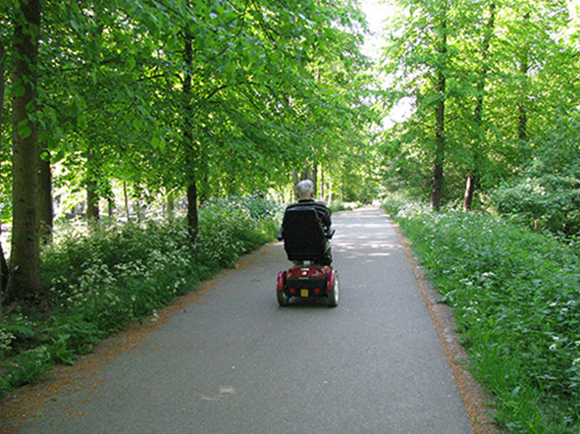
Pedestrian Access Route
Pedestrian Access Route (PAR)
  All the navigable elements that work together to allow pedestrians to move from place to place
  Sidewalk or trail, curb ramp, crosswalks, and APS
  PAR by definition is accessible to all pedestrians

Slide 12
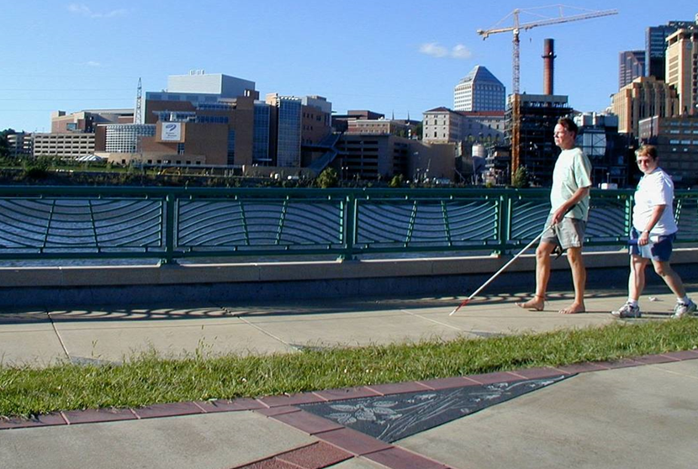
Zone System
Establishing a buffer area between sidewalk and traffic creates a safer and more pleasant place to walk and makes it easier to meet all ADA requirements

Slide 13
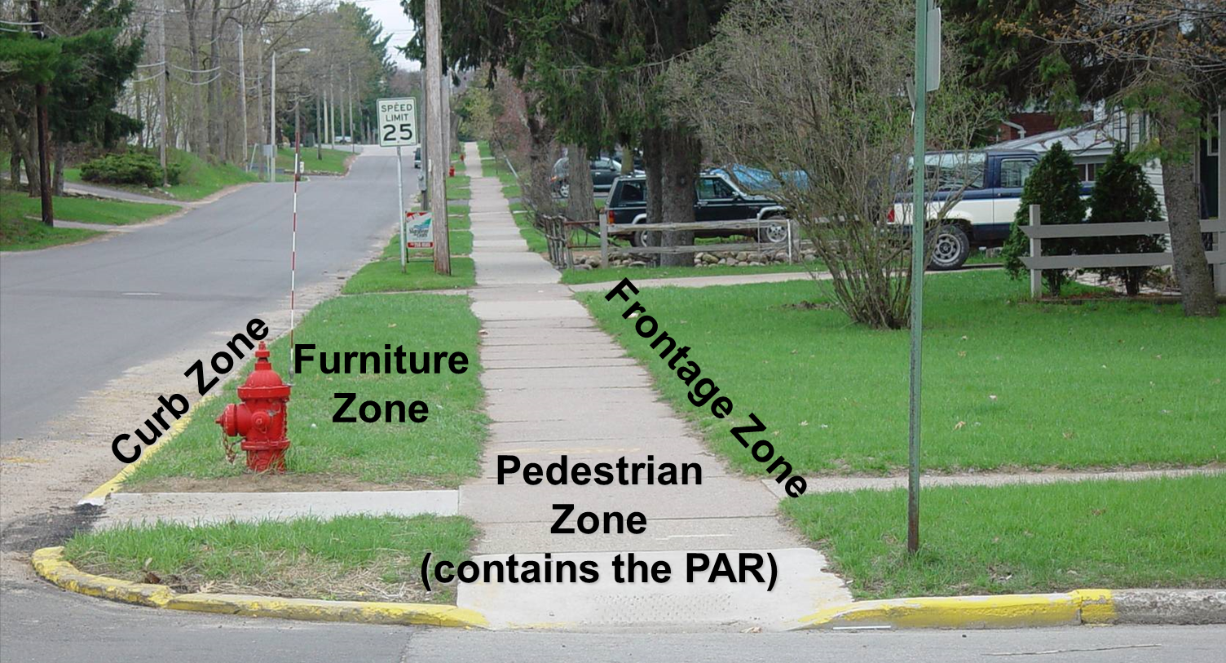

Zone System: Residential

Slide 14
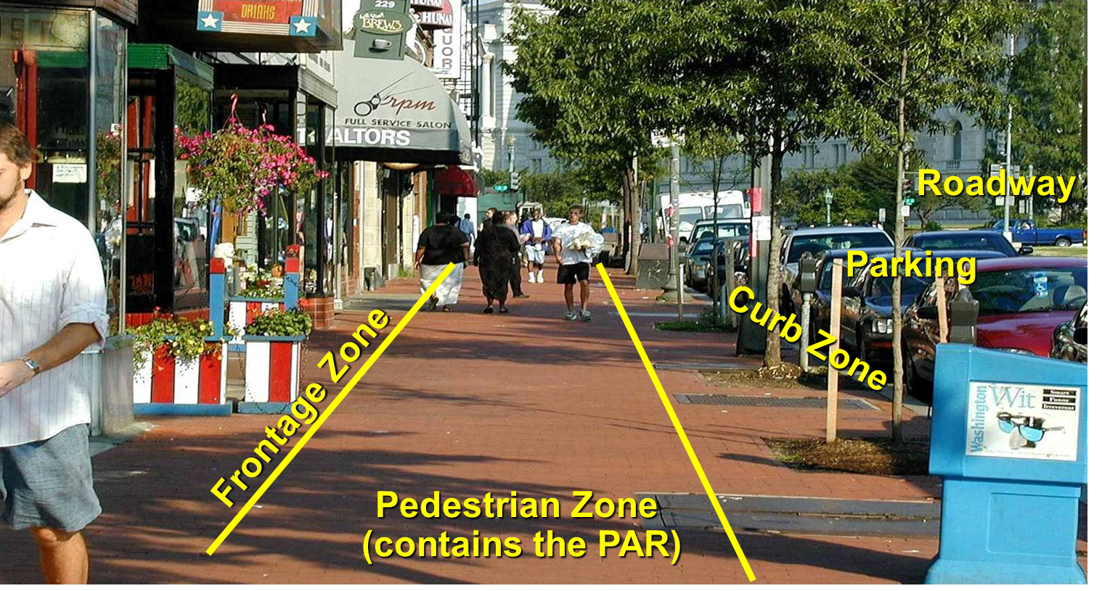
Zone System: Commercial

Slide 15
Zone System: Doorways
Maintain a 5-ft.-wide path when doors of a building are open
3 ft. clearance
recommended between building
and PAR when doors open toward the pedestrian way

Slide 16
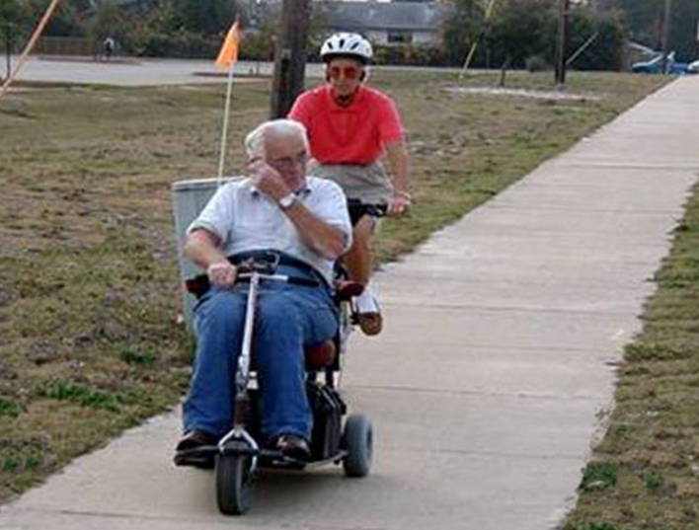
Sidewalk Basics
ADA is an element of good pedestrian design:
  Clear of obstructions
  4 ft. minimum width (5 ft. minimum MnDOT)
  Smooth paved surface
  2% maximum cross slope (1.5% Mn/DOT desired)
  Level and continuous across driveways

Slide 17
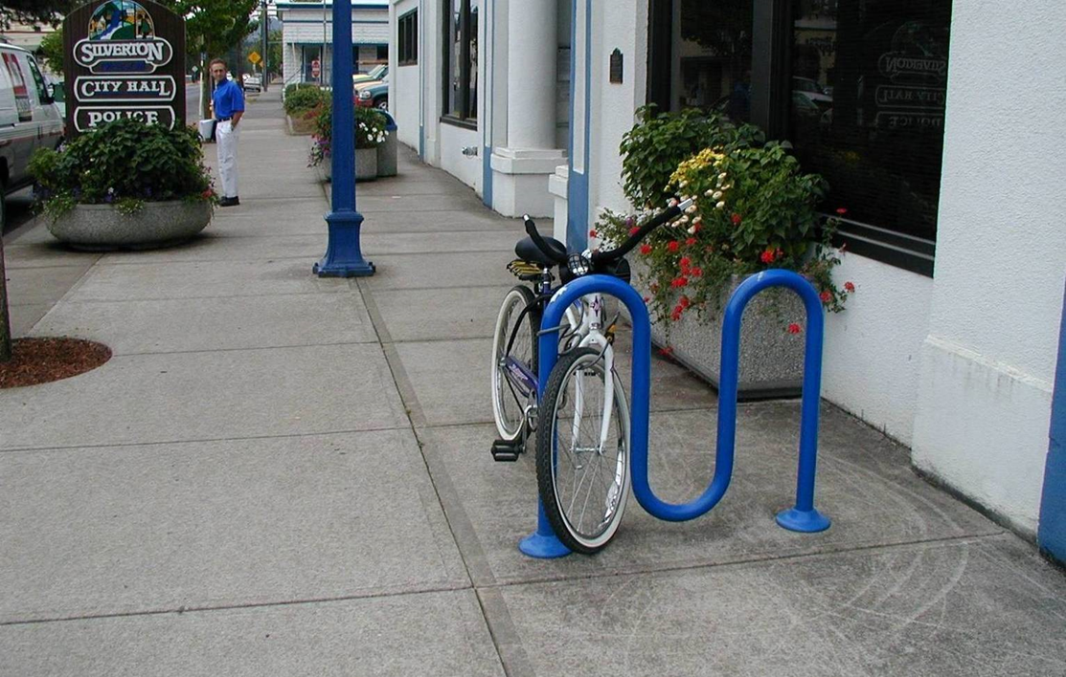
Sidewalk Basics: Obstacles (NO!)
Randomly arranged street furnishings are hazardous clutter.

Slide 18
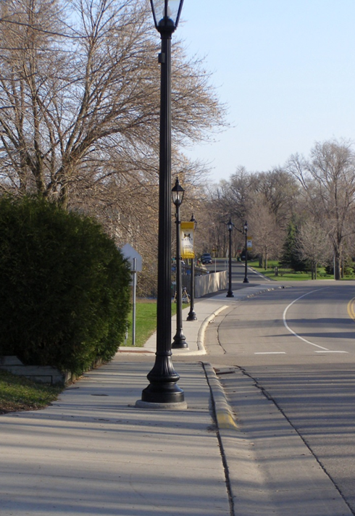
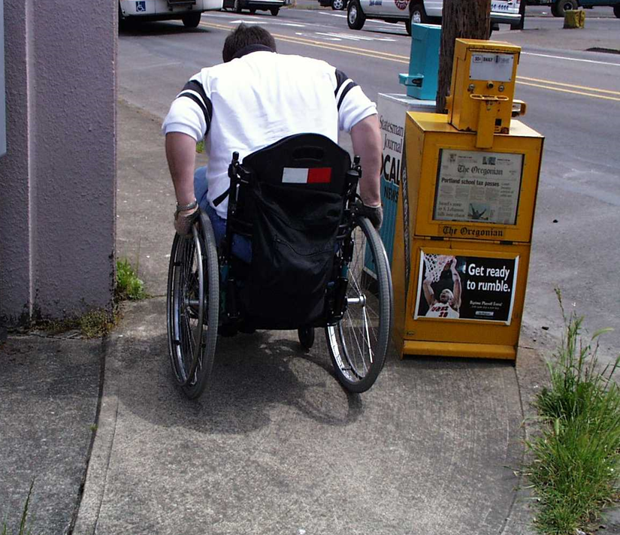
Sidewalk Basics: Obstacles (NO!)
Utilities, poles and boxes pose obstacles.

Slide 19
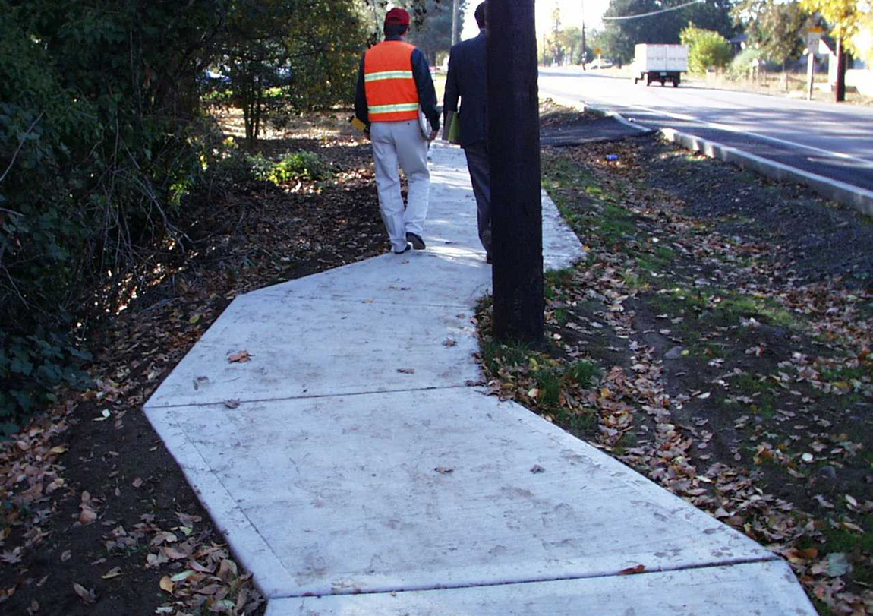
Sidewalk Basics: Obstacle Mitigation
Sidewalks or trails can wrap around obstacles.

Slide 20
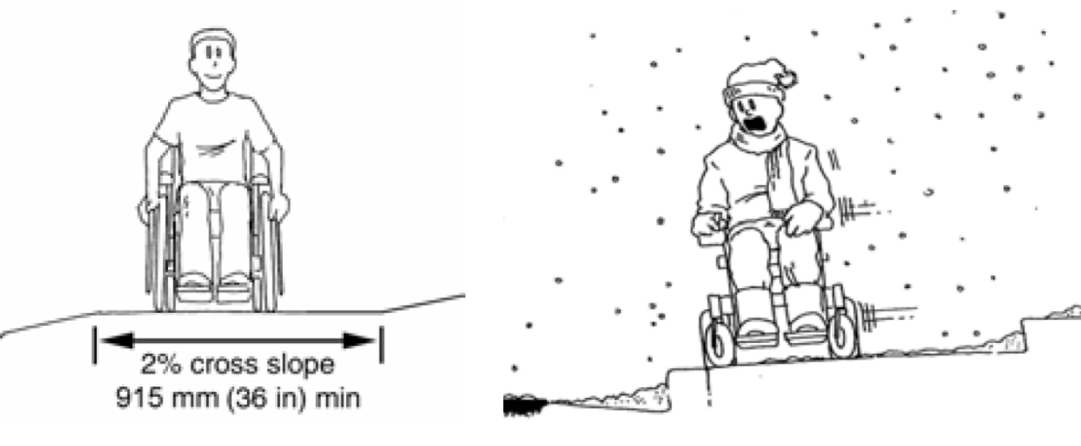
Sidewalk Basics: Cross Slope
Steep cross slopes are inconvenient and hazardous
Require extra effort by wheelchair users to move forward
Become slippery when wet, icy or snowy

Slide 21
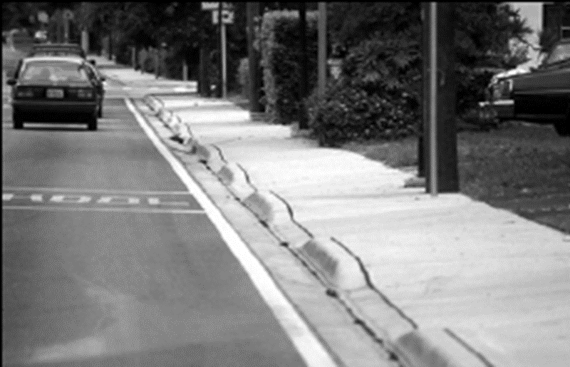
Sidewalk Basics: Driveways
Driveway crossings without level landings force users to travel
over the sidewalk flare.
Results in abrupt
changes in cross slope
Compromises
balance and stability
for wheelchair users
and a hazard for
many others

Slide 22
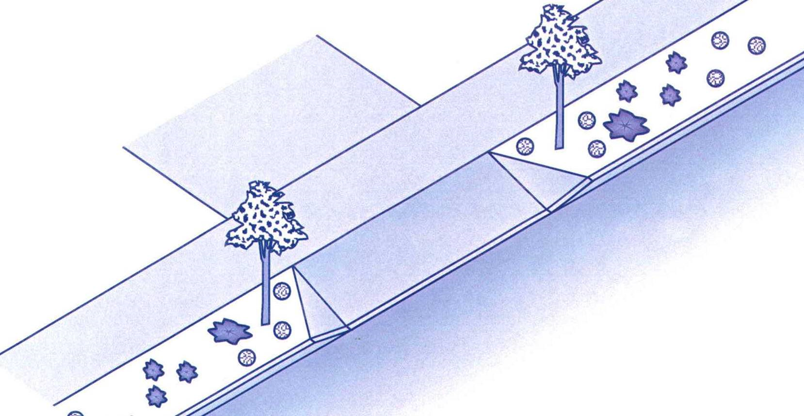
Sidewalk Basics: Driveways
The easiest way to maintain level passage is with sidewalks separated from the road.

Slide 23
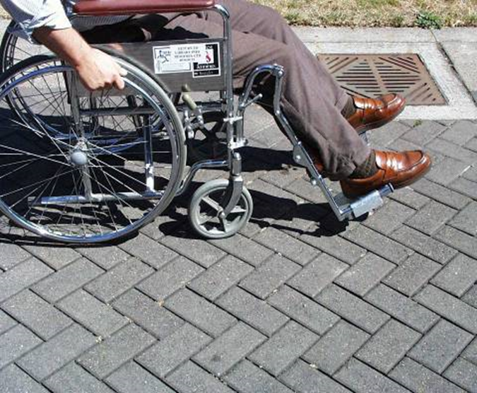
Sidewalk Basics: Surface
Bricks, cobblestones and other textured pavement create:
Increased rolling resistance
Tripping hazards
Painful vibrations to people with brittle bones or spinal cord injuries in wheelchairs
Potential maintenance issues
Strongly discouraged by PROWAG

Slide 24
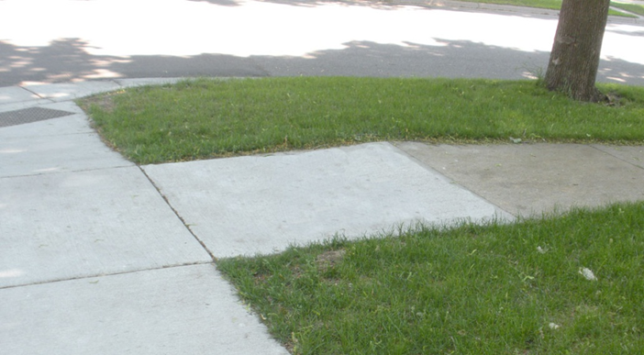
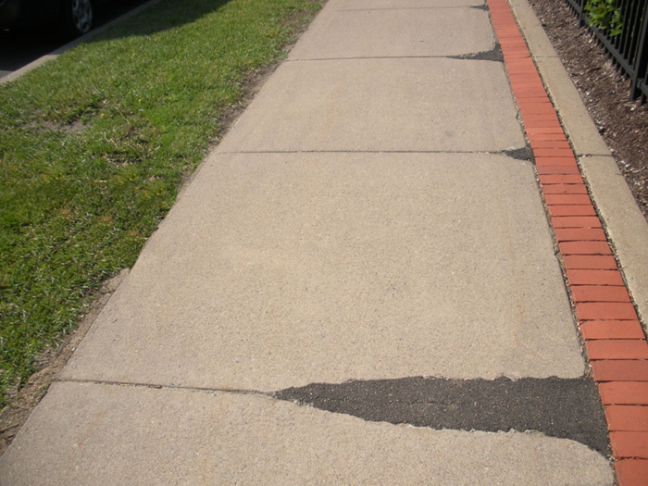
Sidewalk Basics: Surface
Tolerances:
Up to 1/4 inch,
no treatment
1/4 to 1/2 inch,
bevel the surface, with maximum grade of 50%
More than 1/2 in, replace the sidewalk panel

Slide 25
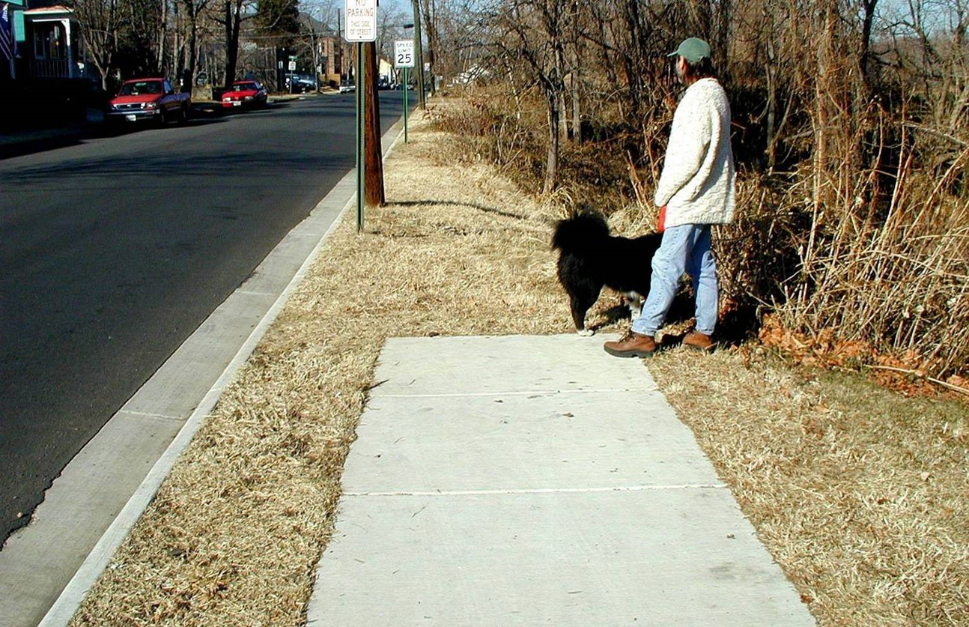
Sidewalk Basics: Continuity/network
Avoid sidewalks to nowhere

Slide 26
Curb Ramp Basics
Minimum 4 ft. wide Pedestrian Access Route (PAR) with a maximum cross slope of 2%
Landing dimensions 4 ft. by 4 ft. minimum with a maximum 2% slope in all directions
If longitudinal slope exceeds 5%, landings must be provided on any pedestrian facility
Maximum ramp slope is 8.3%
Maximum length of ramp is 15 ft.

Slide 27
Curb Ramps: Types
Perpendicular ramp
Parallel ramp
One-way directional ramp
Two-way directional ramp
Depressed corner
Fan ramp
Tiered ramps
Diagonal ramps (not recommended)

Slide 28
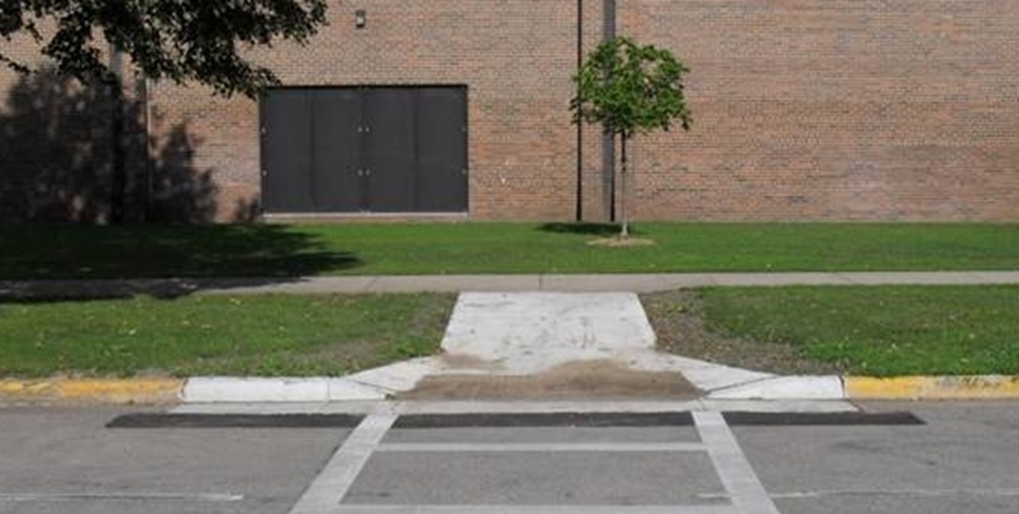



Perpendicular Ramp
Ramp is perpendicular to the curb line.
Grade break occurs at the top of the ramp and the flow line

Slide 29
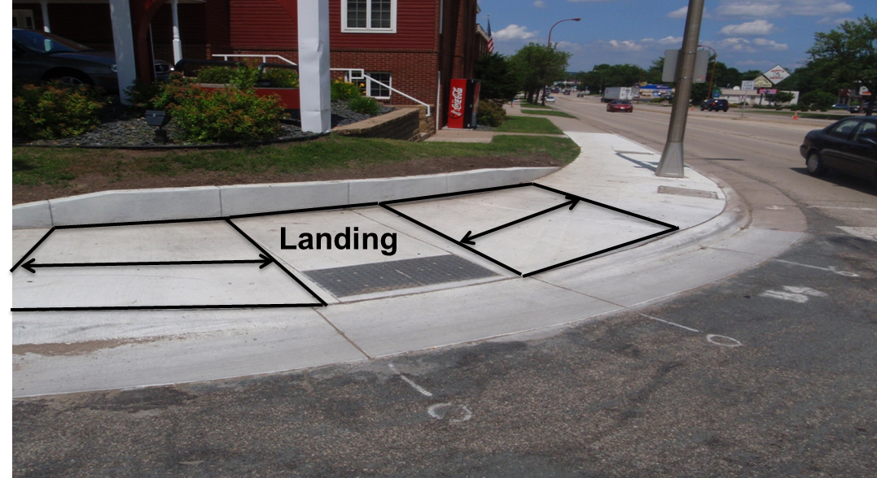
Parallel Ramp
Parallel to the curb line
Used with narrow sidewalks and in tight ROW situations
Slope of curb should match slope of ramp

Slide 30
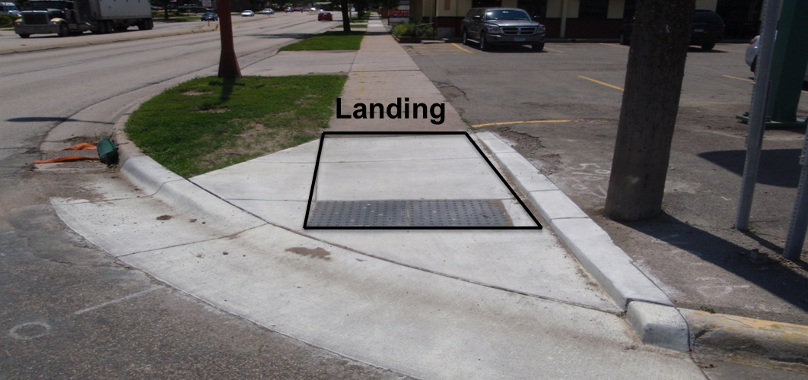
One Way Directional
Grade break occurs at the front edge of the truncated domes and shall be perpendicular to the direction of travel.

Slide 31
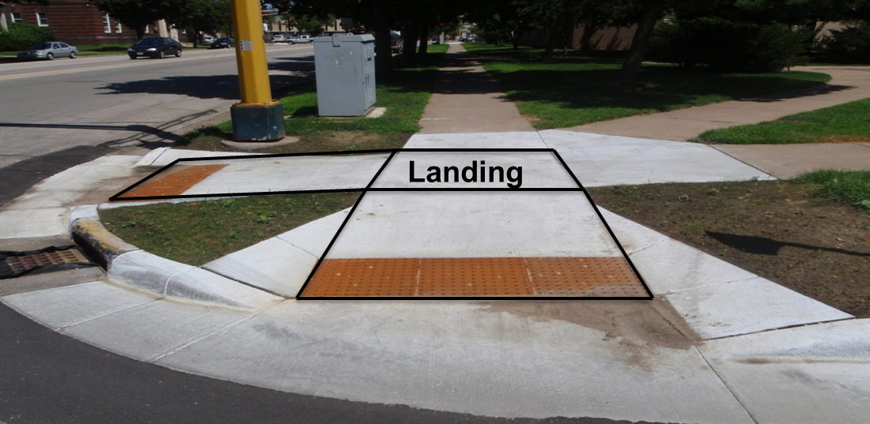
Two-Way Directional
Two ramps with a shared landing
If ramps are directional, the grade break should be at the front of the truncated domes.

Slide 32
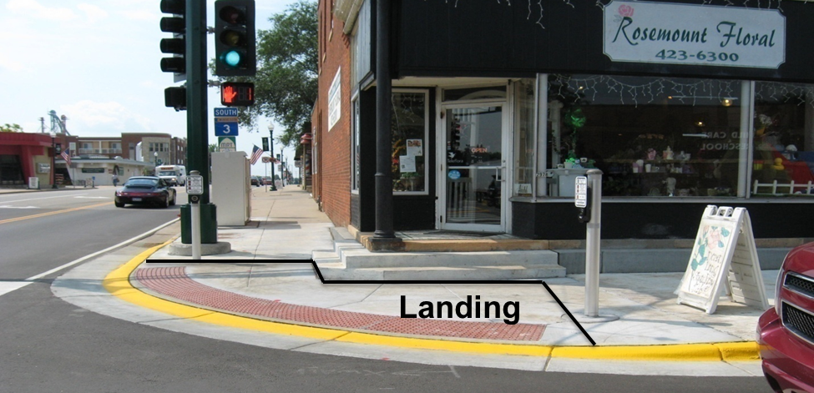
Depressed Corner
Radial truncated domes from outside edge of crosswalk to outside edge of crosswalk
Entire area at 2% maximum slope with parallel ramps/blended transitions rising from the depressed corner

Slide 33
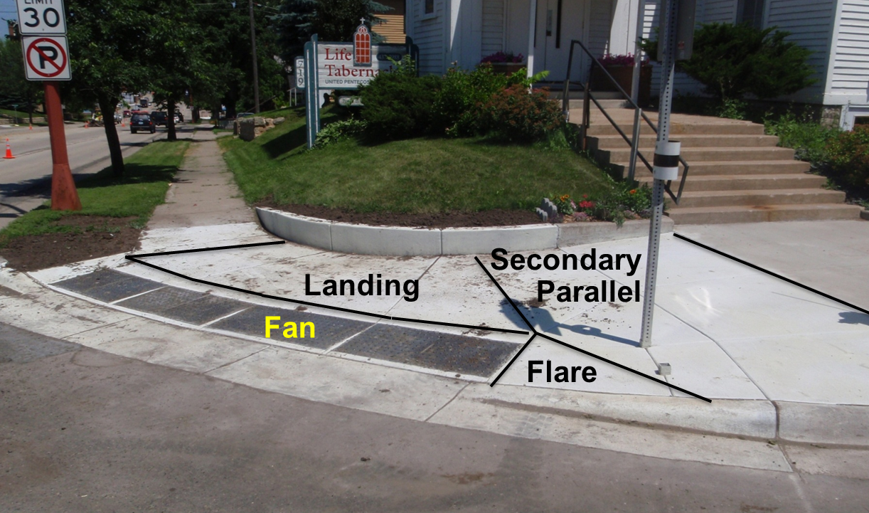
Fan
Ramp slope through the radial truncated dome area with a landing at the top of the ramp
Most difficult type of curb ramp to construct correctly

Slide 34
Design Standards
(what to do)

Slide 35
ADA Minimums
Minimum design approach
  Meets minimum ADA Requirements
  Minimal use of Public Right of Way Guidance (Access Board)
  Rarely acquires ROW or uses innovative design
  More successful in residential areas versus commercial
  Does not always mitigate liability

Slide 36
MnDOT Design Approach
PROWAG is the basis for MnDOT’s Design Standards
Mn/DOT sees PROWAG as a valuable tool in new construction and in improving quality of existing accommodations.
It helps ensure that the same degree of use and access provided to the general public is also available to
pedestrians with disabilities.

Slide 37
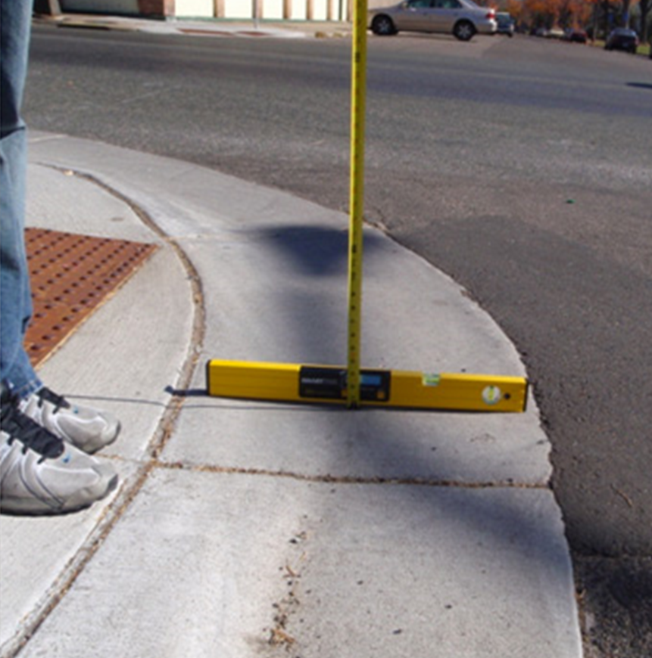
MnDOT Standards
MnDOT Requirements
  Curb Ramp Standard Plans
  Road Design Manual 11-3
  Special Provisions for Construction

Slide 38
Exceptions
Improvements are not required if they would significantly expand project scope. Examples:
  Relocating utilities (more that a hand hole)
  Providing drainage work
  Scope and cost go hand in hand
The earlier the needed improvements are identified—preferably in the project scoping phase—the more likely they will fit within budget and schedule.

Slide 39
Technically Infeasible
Technical feasibility
  Governed by limiting factors in the project area. These may be temporary (a drainage structure) or permanent (adjacent buildings or terrain)
  “Too expensive” is not a factor in technical infeasibility at a project level.
  Cost can be a factor if it poses a programmatic burden on a city, county or state

Slide 40
Maximum Extent Feasible
Maximum extent feasible
  How close a project can come to full accessibility and adherence to standards, given site constraints
  Can be seen as the best solution, working within technical feasibility limitations
  Cost or funding does not determine the maximum extent feasible

Slide 41
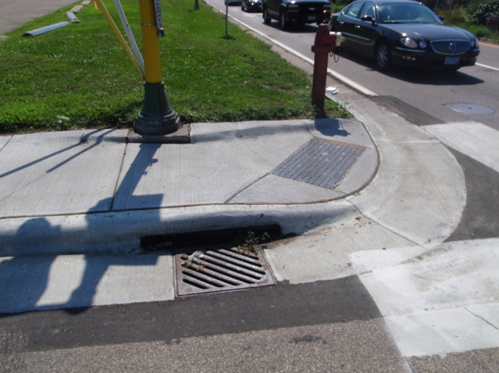
Scoping – Design - Result
A mill and overlay project would typically include upgrading curb ramps…
…unless a complicating factor, such as the catch basin shown below, made the improvement unfeasible within the scope of the original project

Slide 42
Final Thoughts
Aim for GOOD DESIGN, which
meets standards to maximum extent feasible
fits the context
offers a usable solution
Good design does not mean simply applying a standard without considering context.
In certain circumstances, departing from a standard for a good reason may be better than following a standard to the letter.

Slide 43
Thank you again!
Kristie Billiar
kristie.billiar@state.mn.us
651-366-3174

